Slide 1

FoodMeOnce
CS 373 Fall 2019 Group 9

Slide 2





Meet the team!
Chris Chasteen Gyuwon Kim Shub Trivedi Brian Dyck Nithin Pingilli

Slide 3
About the Site
4 sprints
Phase 1: Basic Static Website
Phase 2
Dynamic React Web Application
RESTful API
PostGres DB
Phase 3: Sorting, Searching, Filtering
Phase 4: Visualizations
Models
Districts
Representatives
Legislation
Links
FoodMeOnce GitLab Repository
FoodMeOnce API Documentation
Notes:
Chris

Slide 4
What is FoodMeOnce?
Web Platform to allow users to gather information on food security throughout US Congressional Districts
By combining Disparate Data sources we provide a well rounded perspective on food security in relation to political representation and legislation
Generates Easy to understand Visualizations to allow a quick grasp of Congressional food support using various dimensions such as population, race, and representation.
Notes:
Chris

Slide 5
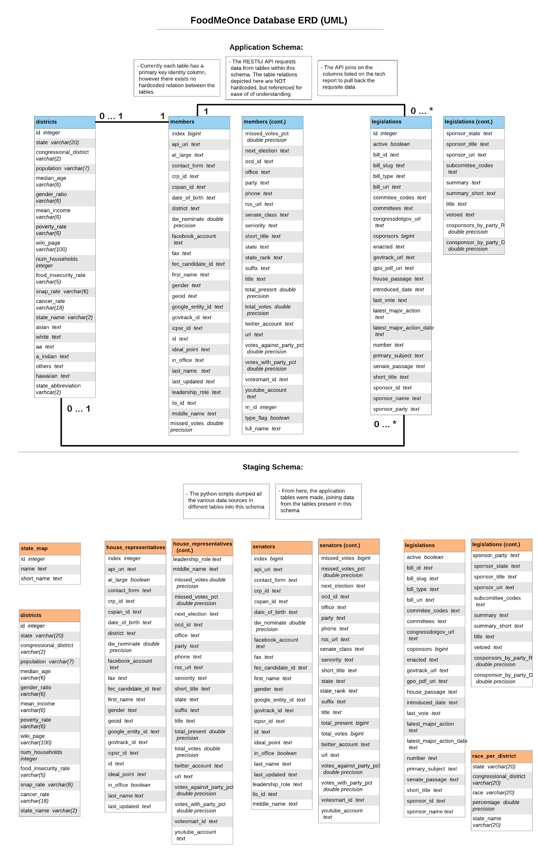
Database
Notes:
Shub

Slide 6
Tool stack
Front-end framework
React Javascript
Bootstrap and CSS
Selenium
Mocha
D3
Back-End Tools
PostgreSQL
POSTMAN
SQLAlchemy
Flask
Python
IDEs
Pycharm IDE
VSCode
Backend
Amazon S3
Domain
NameCheap
Route53
Others
Gitlab
LucidChart
Docker
Gitlab CI/CD
Notes:
Shub

Slide 7
Demonstration
Notes:
Shub - District Sorting, Filtering
Gyuwon - Rep searching
Brian - Site-wide search
Chris - 1st viz
Nithin - 2nd viz & 3rd viz

Slide 8
What did we do well?
Made website dynamic in phase 1
Searching, Sorting, Filtering
Getting each phase reviewed by the TAs
Well paced throughout each phase of the project.
Gitlab Issue Board
Communication with our Customer team
Notes:
Nithin
Shub

Slide 9
What did we learn?
E2E website building
Deploying and hosting in AWS
Designing an API
Domains and subdomains
Database design
React and Flask frameworks
Postman API documentation
Importance of code readability
Notes:
Gyuwon

Slide 10
What can we do better?
UI/UX
Relative spacing of elements on screen
Did not consider mobile usage
Prettier visuals
Splash page
Code refactoring/maintainability
Could have used flask-restless
District model page - dynamic map load time
Notes:
Brian

Slide 11
What puzzled us?
How to get started
Asynchronous API requests
Searching Data
D3
Gitlab CI setup
Notes:
Chris

Slide 12

Developer Team - PutItInPark

Slide 13
What did they do well?
UI/UX is great
On mouse hovering over cards
Overall look and feel
Buttons
Visualizations located on model pages
Pagination has 5 pages
Communicating on user stories was very thorough
Made site mobile friendly
Notes:
Brian

Slide 14
What did we learn from their website?
Technical gains:
Hovering effect over cards
Using entire space for the instance page
Use of icons(search icon, loading icon)
Website specific:
Central USA has the most frequency of parks + recreational activities
Notes:
Nithin

Slide 15
What can they do better?
Meeting phase requirements
API subdomain
Model page search results sometimes do not contain search term
National Parks search
Notes:
Shub

Slide 16
What puzzles us?
Technical puzzles:
How the model specific search works?
Possibly not correctly matching (ex) acadia in National Parks and tenn in States
No highlighting search terms on model specific search
Website down at one point
Website specific:
Why does Central USA have such low visitor count despite having the most parks + recreational activities?
Notes:
Gyuwon

Slide 17
Questions?
Notes:
All of us

Slide 18
Thank you!

